Slide 1
WHERE DO WE GO FROM HERE
COUNTY BUSINESS UPDATE WEBINAR
FRIDAY, MARCH 19TH | 8:30AM

Slide 2
HOUSE KEEPING
SESSION IS BEING RECORDED
IF YOU HAVE QUESTIONS DURING THE PRESENTATION PLEASE USE THE 'Q&A' BUTTON BELOW
CLOSED CAPTIONS ARE AVAILABLE
CAMERAS AND MICROPHONES ARE DISABLED FOR THIS WEBINAR
THIS WEBINAR WILL BE AVAILABLE AT PGCEDC.COM/COVID19

Slide 3
AGENDA
Open Remarks
Federal Government Business Relief Update
Questions & Discussion
Prince George's Forward Task Force | County Update
Questions & Discussion
County Business Success Stories
Next Steps

Slide 4
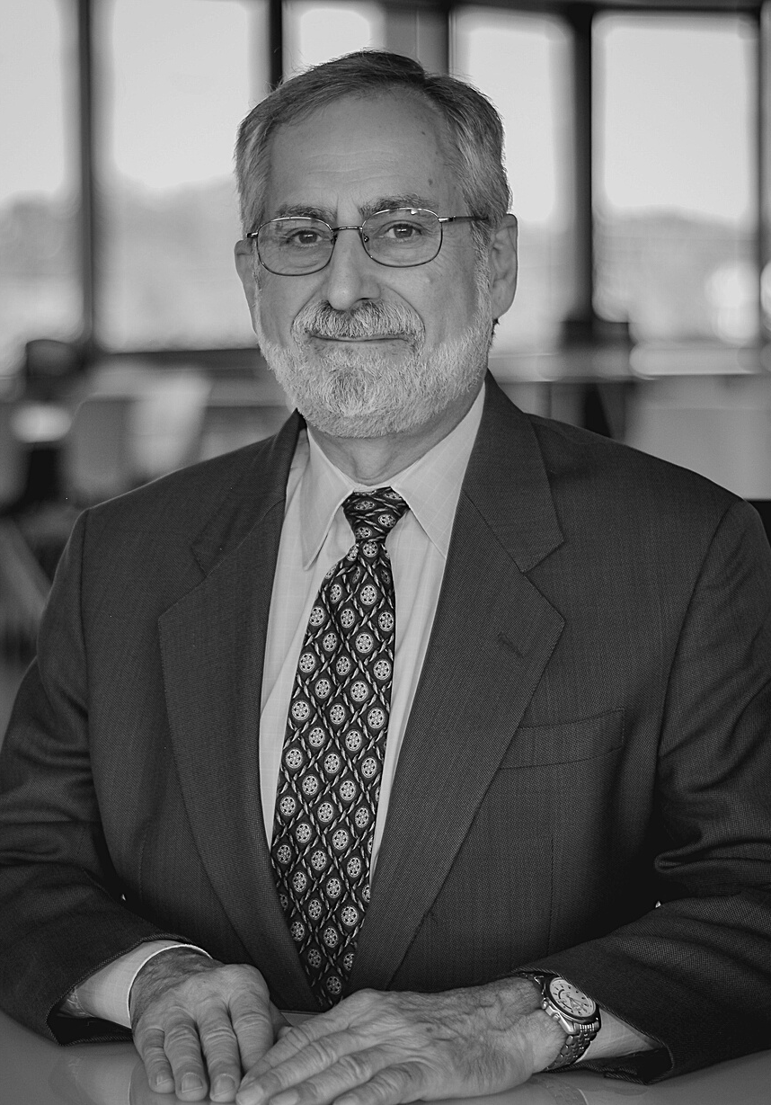
OPEN REMARKS
David Iannucci
President & CEO
Prince George's County Economic Development Corporation

Slide 5
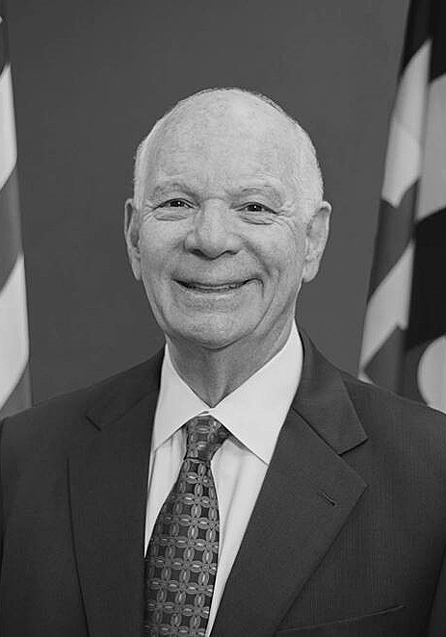
FEDERAL GOVERNMENT UPDATE
U.S. Senator Ben Cardin
Maryland
DISCUSSION TOPICS
$1.9 Trillion COVID Relief Measure

Slide 6
QUESTIONS AND ANSWERS
Please submit your questions in the 'Q&A' box.
We will answer as many as we can.

Slide 7
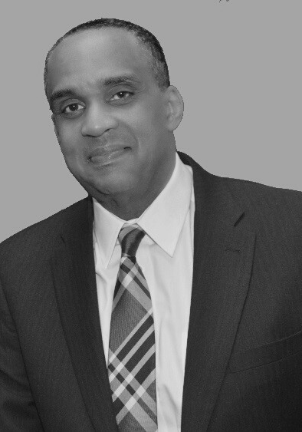
COUNTY UPDATE MODERATOR
David Harrington
President & CEO
Prince George's County Chamber of Commerce

Slide 8
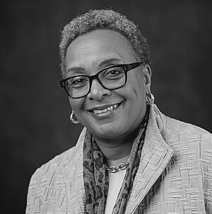
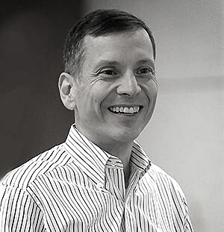
PRINCE GEORGE'S FORWARD TASK FORCE
Dr. Charlene Dukes
Prince George’s Community College, President Emerita
Prince George’s Forward Task Force, Co-Chair
David Velazquez
Pepco Holdings, President and CEO
Prince George’s Forward Task Force, Co-Chair

Slide 9
PRINCE GEORGE’S FORWARD TASK FORCE
Prince George’s County Business Webinar
March 19, 2021
Dr. Charlene Dukes and Mr. David Velazquez
Co-Chairs

Slide 12
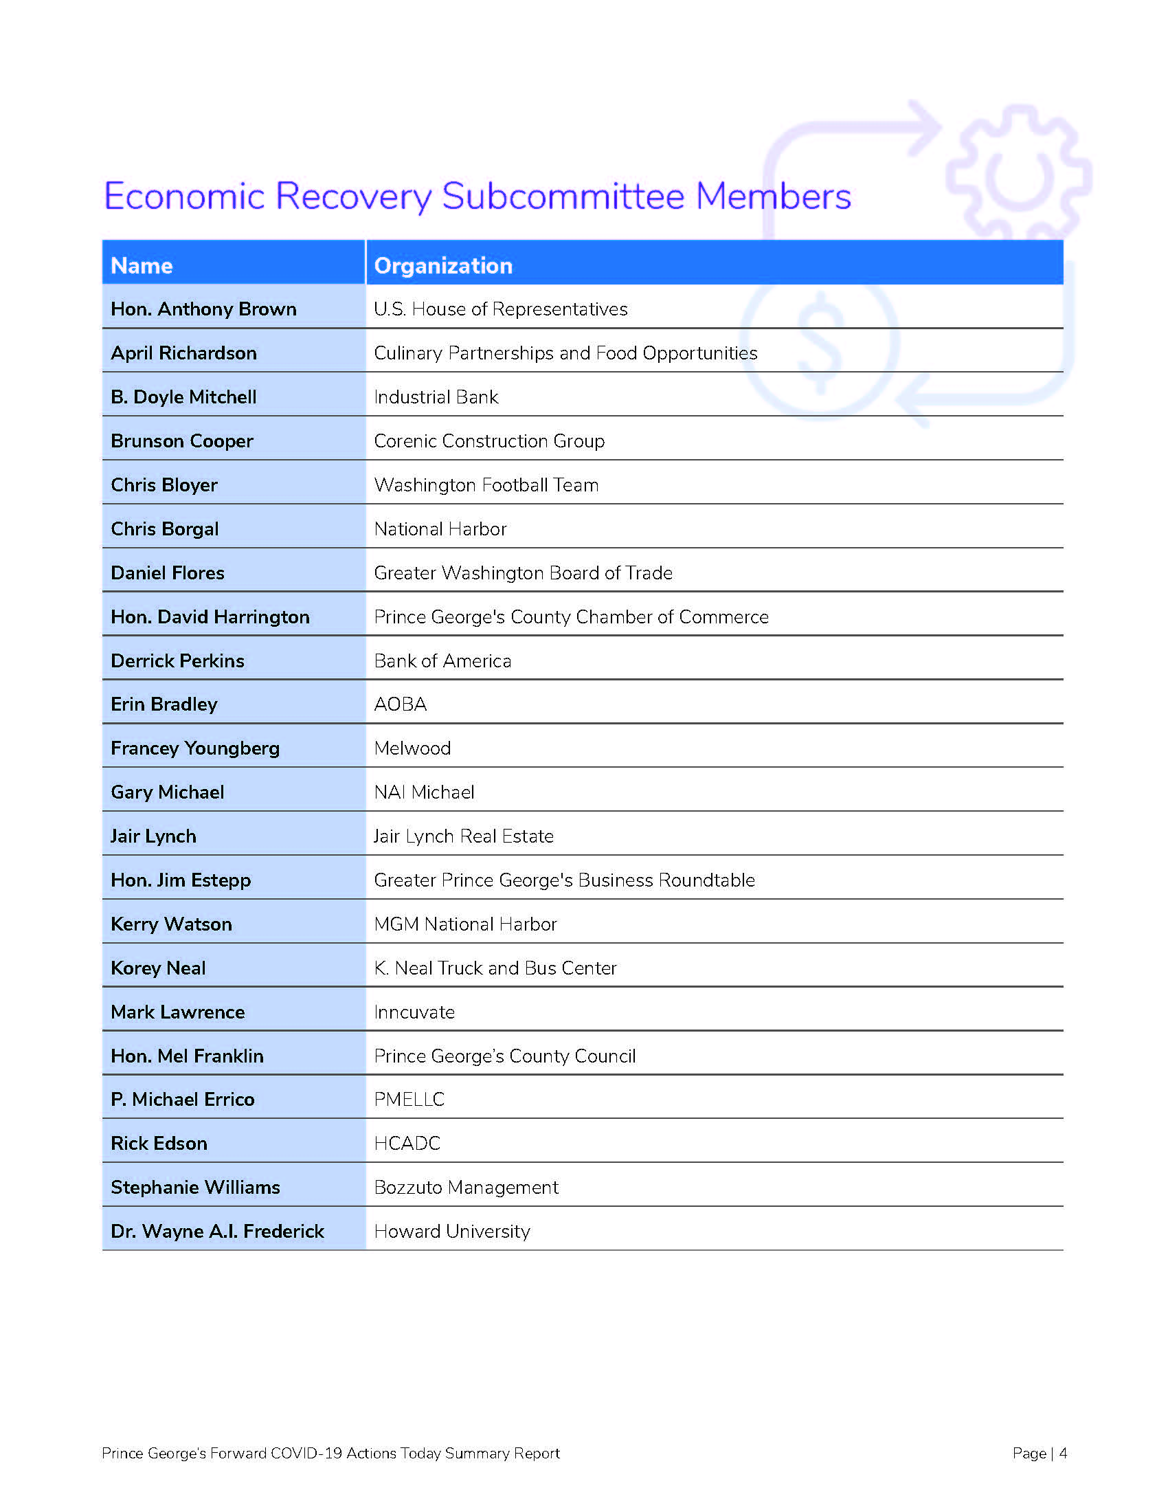

Slide 13
Reports available at:
www.princegeorgesforward.com

Slide 14
Economic Recovery Work Group Mr. Thomas Graham, Chair

Slide 15
Economic Recovery Specific Focus Areas
Jobs recovery/Workforce Development
Business Recovery
Tourism Recovery
Economic Relief
Real Estate Recovery
Mass Transit Guidance
Policies, Tools & Resources

Slide 16
Expand Technical Business Assistance and Support (Actions Today)
Business Recovery Initiative Fund provided $20 million in grants
Restaurant Resilience Fund provided $3.3 million in grants to County-based restaurant and food establishments
The Child Care Provider Recovery Program provided $2 million in grants to licensed child-care centers and registered family child-care centers
Training and technical support for County-based businesses

Slide 17
Department of Permitting, Inspections and Enforcement (DPIE) Customer Satisfaction Survey (Visions for Tomorrow)
Learn from customer experiences
Help establish a baseline for future performance
Notes:
Co-Chair VELAZQUEZ continues
task force though it was very important to get actionable information from past and present customers to gauge their experience navigating the permitting and inspection process
Implementation of the DPIE Customer Satisfaction Survey will provide the administration with the requisite insight, analysis and guidance to improve the regulatory process.
The outcomes will be used to establish a baseline for future performance.
Results will enhance the agency’s customer facing tools and services.
CUE “NEXT SLIDE, PLEASE”

Slide 18
Create lasting capital access for small and minority businesses (Reimagined Future)
Change the narrative of Prince George’s County
Create connections

Slide 19
Improve the regulatory process to attract economic development initiatives (Reimagined Future)
Opportunity to grow and create new employment opportunities

Slide 20
Develop a County-wide workforce development strategy (Reimagined Future)
Increase employment
Create connections from Prince George’s County Schools to Prince George’s County Businesses

Slide 21
Improve entitlement process (Reimagined Future)
Part of comprehensive review
Remove the additional review of projects already approved by the zoning hearing examiner or planning board
Improved transparency in the planning process

Slide 22
Recommendations Across Work Groups
Education
Health care
Government Operations
Human & Social Services
Economic

Slide 23
For any questions or comments, please email: pathforward@co.pg.md.us For general information on our Prince George’s Forward Task Force, go to: www.princegeorgesforward.com
Notes:
.com

Slide 24
Questions and Discussion Dr. Charlene Dukes and Mr. David Velazquez, Co-Chairs

Slide 25
QUESTIONS AND ANSWERS
Please submit your questions in the 'Q&A' box.
We will answer as many as we can.

Slide 26
COUNTY BUSINESS
SUCCESS STORIES

Slide 27
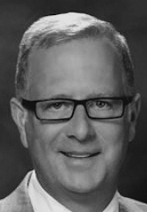
KEANY PRODUCE
Greg Otterbein
CEO
Keanyproduce.com

Slide 28
RESTAURANT ZONE
Adam B. Greenberg
Founder And President

Slide 29
MOORE AND MOORE MERCH
Quianne Perrin
CEO
Themerchstudio.com.com

Slide 30
CLOSING REMARKS
David Harrington
President & CEO
Prince George's Chamber of Commerce

Slide 31
THANK YOU FOR JOINING US
PGCEDC.com/contact-us1
301-583-4650
Business.pgcoc.org/contact
301-731-5000

