Slide 1
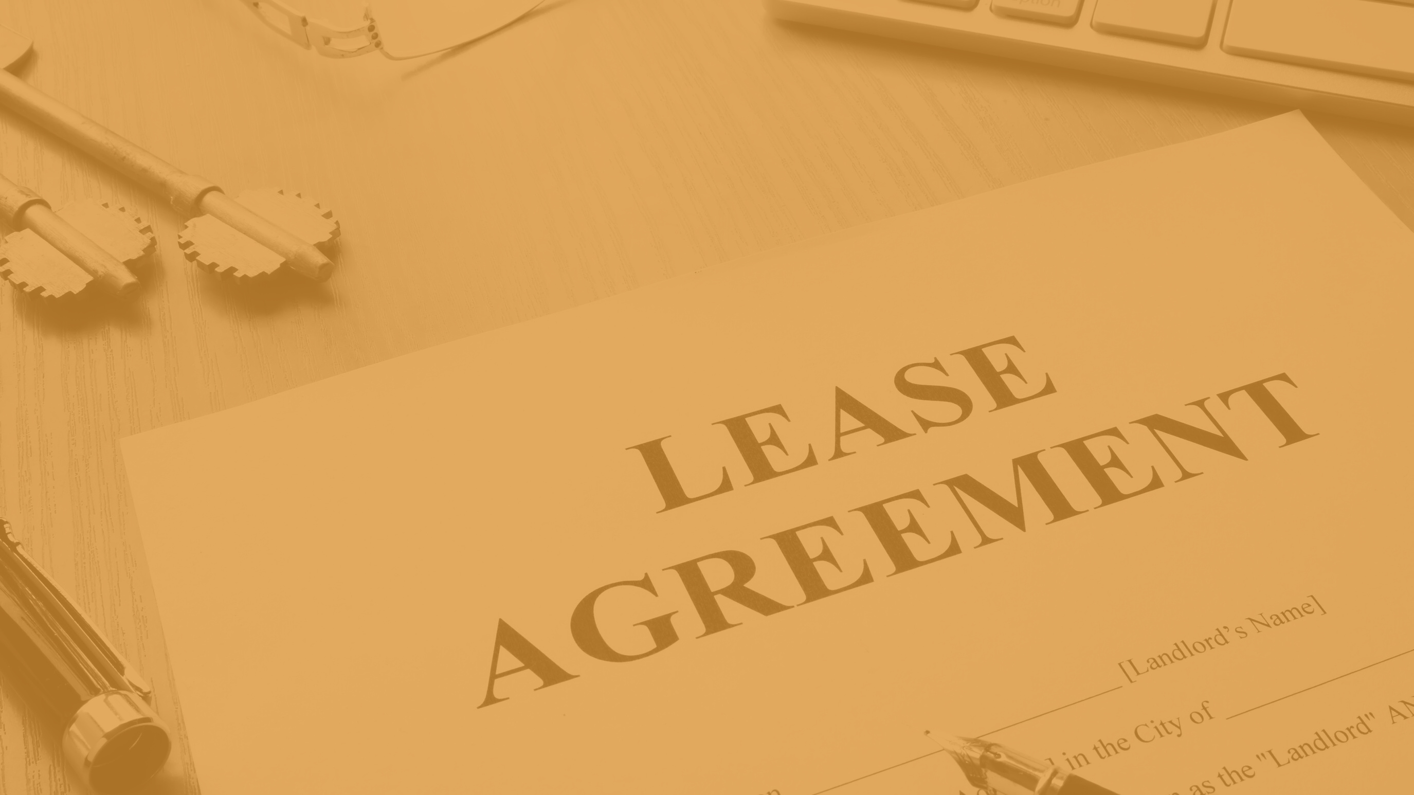
PATHWAYS
TO GROWTH & EXPANSION
Powered by Prince Georg'es County Economic Development Corporation
LEASE AGREEMENTS AND COMPLETING LEASE HOLD IMPROVEMENTS
WEDNESDAY, JANUARY 12, 2022
Sponsored By:

Slide 2
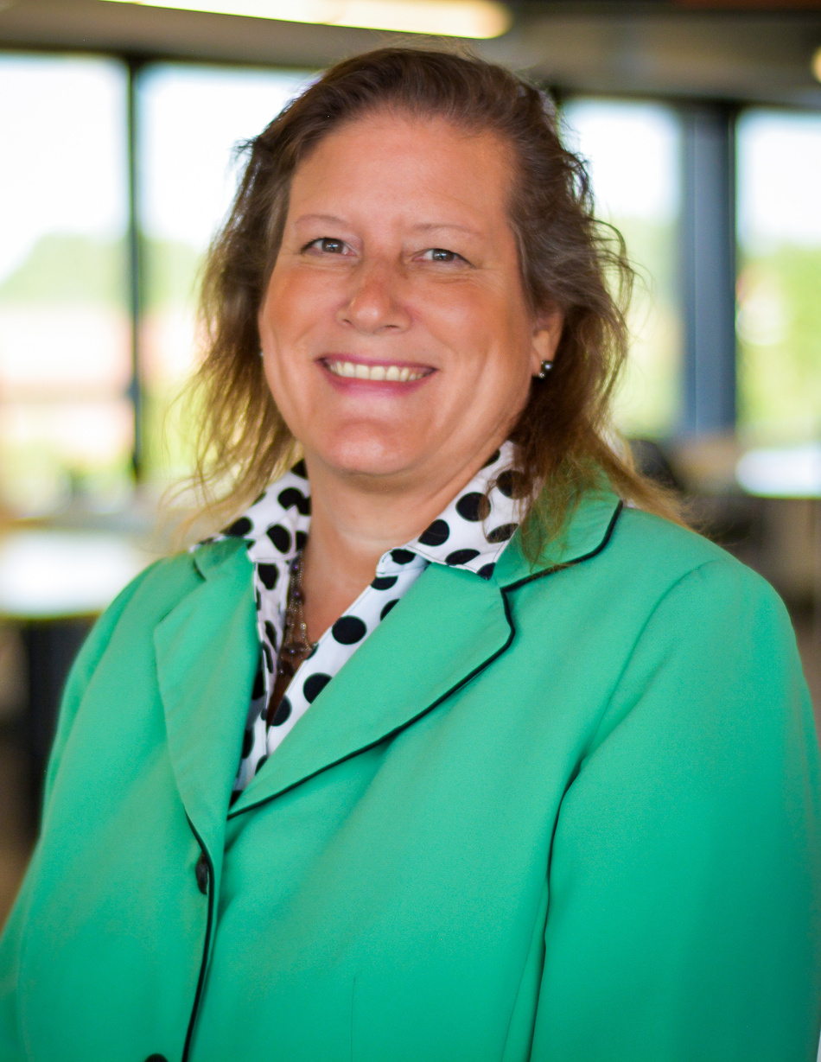
PATHWAYS
POWERED BY PRINCE GEORGE'S COUNTY ECONOMIC DEVELOPMENT CORPORATION
Alicia Moran
Manager of Small Business Services
Amoran@co.pg.md.us
301.583.4604

Slide 3
PATHWAYS
POWERED BY PRINCE GEORGE'S COUNTY ECONOMIC DEVELOPMENT CORPORATION
PATHWAYS
POWERED BY PRINCE GEORGE'S COUNTY ECONOMIC DEVELOPMENT CORPORATION
There are many pathways to growing a successful business. The Prince George’s County Economic Development Corporation (PGCEDC) is proud to present our own Pathways - a dynamic series of programs that take a deep dive into important economic development and business topics dedicated to growing our local business eco-system.
Our goal is to educate, inform and prepare local business owners to be at the top of their game when it comes to business expansion, management, financing, company finances and how to secure top level contracts. Together, with industry experts, we are Prince George’s Proud to be your resource partners for business growth.

Slide 4
CREANDO EXITOS
TAKE OUT TUESDAY
"Creating Success" to connect Spanish speaking County Businesses with information and resources to help them thrive.
Calling all County foodies and beyond! Explore all there is to eat in the County and where you can #DinePrinceGeorges!
PGCEDC PROGRAMS
PATHWAYS
POWERED BY PRINCE GEORGE'S COUNTY ECONOMIC DEVELOPMENT CORPORATION
PATHWAYS
BUSINESS SPOTLIGHT
A dynamic series of programs that take a deep dive into important economic development and business topics dedicated to growing our local business eco-system.
Showcasing local businesses making a difference in Prince George's County
BUY PRINCE GEORGE'S
Connecting and promoting local businesses with County residents shopping for goods and services through an online registry.
#BuyPrinceGeorges

Slide 5
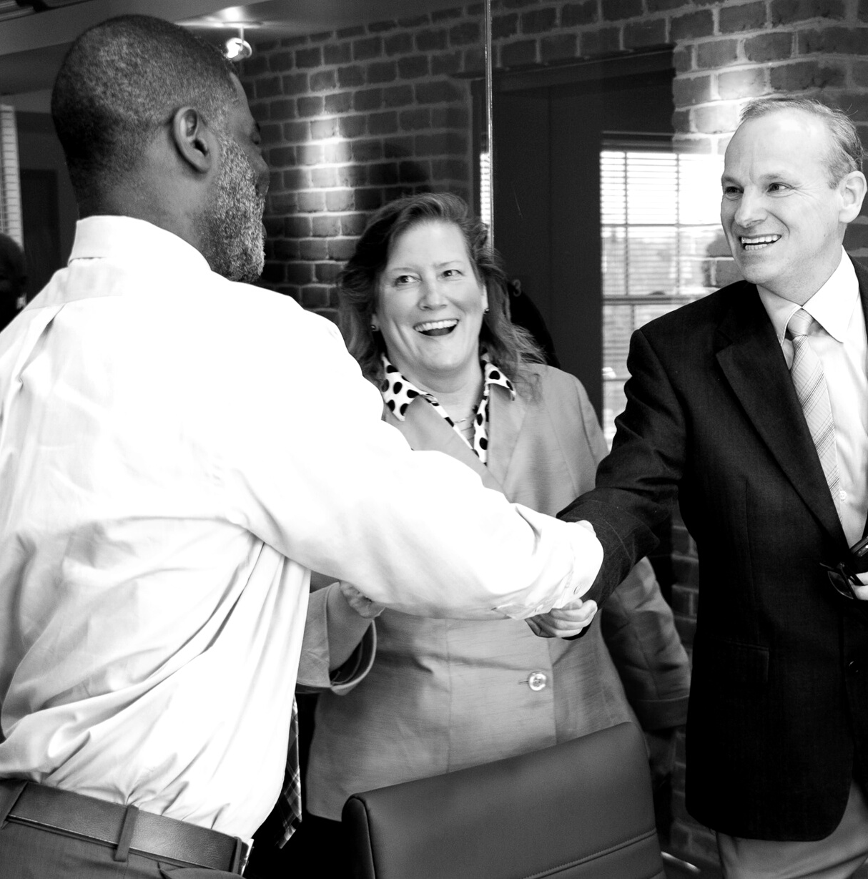
PATHWAYS
EDC CORE SERVICES
POWERED BY PRINCE GEORGE'S COUNTY ECONOMIC DEVELOPMENT CORPORATION
Business Community Proponent
Strategic Plan Update
Site Selection
Economic and Demographic Data
Leasing and For-Sale contact information
Permit Assistance
Targeted Attraction and Retention
Pre-submission meetings with multiple agencies
Expedited Services
Problem Solving and Intervention
Identification of appropriate incentives
Marketing, Promotion and Communication
Networking and Connections

Slide 6
PATHWAYS
POWERED BY PRINCE GEORGE'S COUNTY ECONOMIC DEVELOPMENT CORPORATION
BUSINESS
DEVELOPMENT TEAM

Slide 7
PATHWAYS
SMALL BUSINESS SERVICES
POWERED BY PRINCE GEORGE'S COUNTY ECONOMIC DEVELOPMENT CORPORATION
Business Development Trainings & Workshops
Access to Financing
Connections with resource partners
SCORE, SBDC, PTAC, MWBC, TEDCO
Connections to other Business Incubators
Site Selection
Innovation Station Business Incubator Co-working and Virtual Space
Procurement support and Certification support
Access to coaches, counselors and mentors

Slide 8
Business Resources
FIRST
FRIDAY
Coaching Session
LERCH, EARLY, BREWER
FIRST FRIDAY COACHING
MARYLAND BUSINESS: REBOOT
GLOBAL ENTREPRENEURSHIP
This is an Innovation Station sponsored series. Legal topics presented by LEB in partnership with PGCEDC.
Legal Aspects of Buying and Selling a Business
The Legal Elements of Company Formation
Employment Law
Contract Law
www.pgcedc.com
In partnership with the University of Maryland Global Campus, Innovation Station hosts a monthly business coaching program to help guide companies through turbulent times and opportunities.
www.pgcedc.com/events
Free programs to Maryland residents and business owners
presented by professors at the Robert H. Smith School of Business and focus on finance, marketing, business operations and more.
www.Rhsmith.umd.edu
November 8-14, workshops, programs, pitch competitions, and networking events will be held throughout Prince George’s County and the world to connect entrepreneurs to resources and opportunities.
www.genglobal.org

Slide 9
PATHWAYS
POWERED BY PRINCE GEORGE'S COUNTY ECONOMIC DEVELOPMENT CORPORATION
For More Information Regarding Pathways and
EDC Services
CRYSTAL BALLARD
Business Development Program Coordinator
CKballard@co.pg.md.us
ALICIA MORAN
Small Business Services Manager
Amoran@co.pg.md.us
www.PGCEDC.com/pathways

Slide 10
The Lease and Your Business
Common Terms and Issues
Ann Marie Mehlert and Steven F. Dunn
Attorneys
Lerch, Early & Brewer

Slide 11
Overview
What is a lease and why are leases important to your business?
Key parts of a lease
The Work Letter
Tenant Allowance
Operating Expenses and Taxes
Default
Q&A

Slide 12
What is a Lease?
Agreement between landlord and tenant for tenant to occupy landlord’s property.
Rent is one of the biggest expenses for a tenant’s business, and landlords often depend on rent to pay the mortgage.
An often complex contract that deals with the right to occupy and use real estate and improvements.
There are many types of commercial leases: office, retail, warehouse, restaurant, etc.

Slide 13
Key Lease Terms
The Premises
Commencement Date(s)
Rent
Additional Rent
Term
“Triple Net” or “Gross”
The Work Letter
Default
Insurance
Use Restrictions
Options

Slide 14
Critical Dates in a Lease
Commencement Date of Lease
Different from Rent Commencement Date
Construction Period – No rent or rent is abated
Delays in construction delays commencement of rent
Rent Commencement Date
Certain number of days after construction starts
Or when Tenant opens for business
Negotiate extension of the Rent Commencement Date
One day for each day in delay in construction
No extension for Tenant delays

Slide 15
Additional Rent: Expenses and Taxes
Two main categories: Operating Expenses & Taxes
Operating Expenses: maintenance, insurance premiums, janitorial services, utilities, waste removal, management
Taxes: property taxes, water and sewer charges, special assessments, tax appeal expenses.
Other types of Additional Rent

Slide 16
Building Out the Space
Your lease will govern what you can do in the space and how you can alter the space
Permitted Uses – defined in the Lease
Alterations – subject to Landlord’s approval
Cosmetic alteration - no Landlord consent
Initial Alterations – negotiate before Lease is signed

Slide 17
The Work Letter
Work Letter is an exhibit to the Lease and defines the roles of the Tenant and Landlord. Your Work Letter should
Clearly define Landlord Work and Tenant Work
Set forth the approval process for approving works or changes
Include time frame for approval responses
Set forth what would be a Tenant Delay
Set forth requirements for contractors
Who obtains the permits

Slide 18
Initial Alterations – Tenant Buildout
Find perfect space but need alterations
Test fits
Develop Plans
Who does the buildout – Tenant? Landlord? Or Combination?

Slide 19
Landlord Performs the Build Out Work
Positives for Tenant
already has its contractors/architects in place
Responsible for getting permits include Use and Occupancy
Responsible for Costs
Negatives for Tenant
No control over timing and buildout process
May be more difficult to make any changes during the buildout
Most likely have to settle for Landlord standard finishes

Slide 20
Tenant Performs Buildout Work
Positives
Control of buildout
Can make minor adjustments and changes
Controls costs
Negatives
Landlord must approve all plans and all changes to plans
Have to find contractors
Responsible for obtaining all permits
Delays in process may not delay rent commencement

Slide 21
Checklist for items in Lease relating to Tenant Buildout
The following should be addressed in the Lease before you sign:
Plans for the alterations to the space
Landlord’s Work – defined in the Work Letter
Tenant’s Work – defined in the Work Letter
Who obtains the Permits
Tenant Allowance – how used and disbursed
Approval process for plans, change orders and contractors
Delays in construction
How long is the construction period (no rent)
Extension of the Rent Commencement Date if there are delays
On expiration of the term of the Lease what alterations can the Tenant take with it

Slide 22
Tenant Improvement Allowance
Tenant performs buildout and Landlord gives funds to perform buildout
Allowance is a loan by Landlord – paid back in monthly rent
Require allowance to be disbursed to pay invoices rather than as a reimbursement
What can it be used for
Who gets the balance if there is money left over

Slide 24
DPIE Business Development Section (BDS) January 12, 2022
Melinda Bolling
Director
Angela D. Alsobrooks
County Executive

Slide 25
About BDS
Support the growth of a thriving and diverse commercial business community
Provide guidance and assistance through the permitting and licensing process

Slide 26
About BDS
Coordinate with agency personnel to facilitate the completion of paperwork and document review
Educate business owners about DPIE requirements and processes
Liaise with entrepreneurs and other government agencies

Slide 27
Zoning Review
Zoning review is an important part of the DPIE permit approval process.
The review is performed by the Maryland-National Capital Park and Planning Commission (M-NCPPC), which is commonly referred to as Park & Planning.
It is recommended that businesses obtain a letter of use determination before signing a lease or buying property.
This can be done by contacting the M-NCPPC Information Services team by submitting the online request form. The form can be found on the Planning Information Services page of the M-NCPPC website.

Slide 28
Zoning Approval
to build on vacant land
to add an addition to an existing business building
to change the exterior of the building
to change the “use” of the building

Slide 29
Building Permits Defined

Slide 30
Use and Occupancy (U&O) Requirements
Permit needed to occupy the premises, regardless of construction or no construction.
Business identified meets local zoning and safety requirements and may legally operate at that location.
Must obtain a U&O when there is a change in tenancy or property owner
Method of compliance – no grandfathering.

Slide 31
U&O Inspections
For a U&O Inspection, the inspector will verify that a building meets zoning, property maintenance and life safety requirements.
You may review the U&O Checklist at https://www.princegeorgescountymd.gov/DocumentCenter/View/10958/Use-and-Occupancy-Checklist-and-Letter-PDF?bidId=
It is important to remember that a U&O permit is not a permit for construction. Rather an applicant must possess a building permit to proceed with construction.

Slide 32
U&O Checklist

Slide 33
U&O Checklist, continued

Slide 34
U&O Checklist, continued

Slide 35
Top 10 Hints
Know the timing of your project
Get a zoning determination prior to signing a lease
Try, if at possible, to go into similar prior use space
When buying, inquire about prior permits, or research online
Hire a professional; use professional to submit application
Be very descriptive when filing application
Consider Third Party programs, “time is money”
Have plans on site, when the Inspector shows up
Ask your contractor to add you to ePlan
Check ePlan updates regularly – log in or check email

Slide 36
Thank You!
Nicole Reece
301-636-2035
nmreece@co.pg.md.us
dpie.mypgc.us

